Slide 1
Visibility of claims in the Claims Portal:
Updated May 2024: New symbols introduced; types of user profiles updated; scenarios updated
A guide for Compensators
This guide provides an overview of the profiles available to Compensators.
It shows how actions taken by claim handlers affect the visibility of claims and covers the following scenarios:
1 – Claim is not allocated to a specific user
2 – Claim is allocated to specific Branch
3 – Claim is accepted by a Comp Branch Claim Handler
4 – Claim response is returned to the Claimant Representative
5 – Claim response is allocated to a specific claim handler

Slide 2
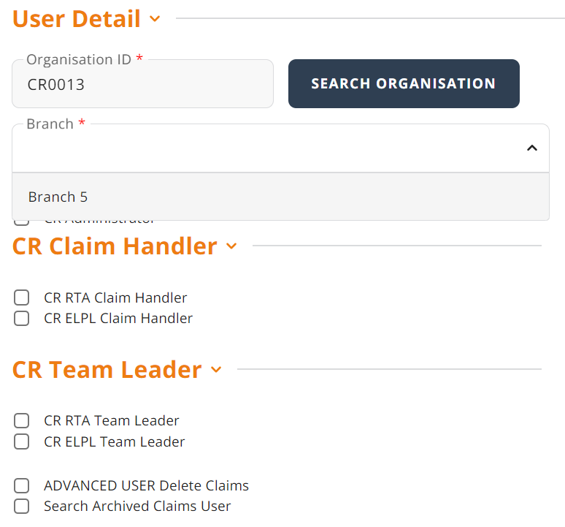
Introduction
This document provides an overview of the visibility of claims, i.e. how compensators may view and work on claims depending on their profile.
Definition of Terms
Assigned Branch
Every user profile must be assigned to a branch, even if their profile is not a branch restricted one.

Slide 3
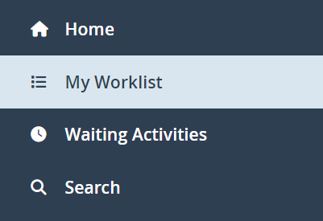


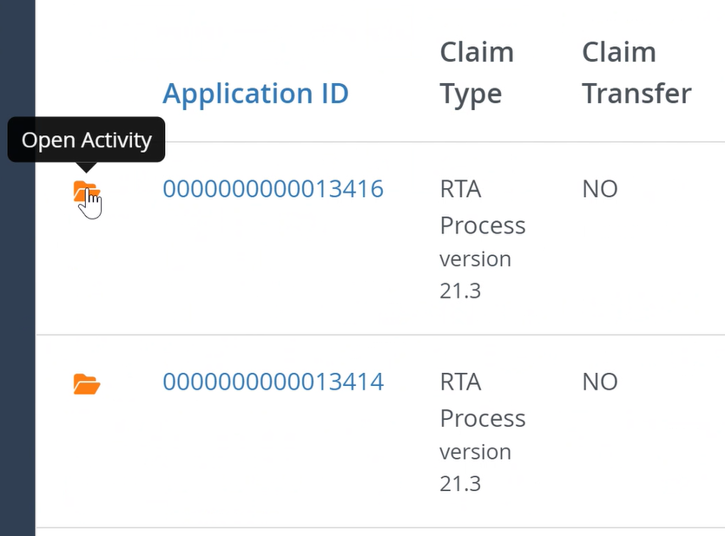

Definition of Terms continued…
View claim
Work on a claim
Being able to view a claim means you:
Can search for and have results returned for a claim using the ‘Search’ function
Can view the claim details in ‘read only’ mode by clicking the ‘View Process Details’ icon
This function is shown using this image:
You can work on a claim if you can access it from your Worklist and can open the activity.
This function is shown using this
image:

Slide 4


Definition of Terms continued…
Allocated Branch
Allocated to User
Compensators may allocate a claim to a specific branch to place the claim into different teams within the Portal, to reflect different departments, geographies, responsibilities and/or scope of work.
Users with a Team Leader profile can choose to allocate a claim to a specific handler. The claim is then only visible in the Worklist of this handler. It is still possible for other users to locate the claim via the Search function.

Slide 5
Visibility Key
for the scenarios on the following slides
  Full access to a claim to search, view and work on:
  Access to search and view a claim, but not to work on:
  No access (claim not found if searched for):

Slide 6
Overview of available profiles
This guide covers the usage of the following profiles:
COMP RTA Claim Dispatcher COMP ELPL Claim Dispatcher
COMP RTA Branch Claim Dispatcher COMP ELPL Branch Claim Dispatcher
COMP RTA Claim Handler COMP ELPL Claim Handler
COMP RTA Branch Claim Handler COMP ELPL Branch Claim Handler
COMP RTA Claim Handler Team Leader COMP ELPL Claim Handler Team Leader
If your organisation has been registered for RTA claims only, please use the RTA specific profiles.
If your organisation has been registered for EL/PL claims only, please use the EL/PL specific profiles.
If your organisation has been registered for both RTA and EL/PL, please consider how you split the work between RTA and EL/PL. If a user handles both types of claims, you need to assign both the RTA and EL/PL profiles to the user (multi-profile).

Slide 7
The visibility of an RTA and an EL/PL claim is shown below:
RTA
EL/PL
Comp Handler 1:
Multi-profile
COMP RTA Claim Handler
COMP ELPL Claim Handler
Comp Team Leader 1:
Multi-profile
COMP RTA Claim Handler Team Leader
COMP ELPL Claim Handler Team Leader
Comp Handler 1:
Multi-profile
COMP RTA Claim Handler
COMP ELPL Claim Handler
Comp Team Leader 1:
Multi-profile
COMP RTA Claim Handler Team Leader
COMP ELPL Claim Handler Team Leader
Comp Handler 2:
COMP RTA Claim Handler
Comp Team Leader 2:
COMP RTA Claim Handler Team Leader
Comp Handler 2:
COMP RTA Claim Handler
Comp Team Leader 2:
COMP RTA Claim Handler Team Leader
Comp Handler 3:
COMP ELPL Claim Handler
Comp Team Leader 3:
COMP ELPL Claim Handler Team Leader
Comp Handler 3:
COMP ELPL Claim Handler
Comp Team Leader 3:
COMP ELPL Claim Handler Team Leader
The example above shows the Handler and Team Leader profiles, but the same rules apply to Branch specific and Dispatcher profiles.
Notes:
Same or different branches?

Slide 8
Scenario 1 – A CNF is not allocated to a specific user
In this scenario there are two branches. A CNF is sent to the Compensator and it is automatically allocated by the system to Branch 1, the ‘Central Point’, but not to a specific user
Please note that all profiles in these scenarios are Compensator specific unless indicated otherwise. The prefixes COMP and RTA/ELPL have been omitted due to space restrictions. For example, COMP RTA Branch Claim Handler is abbreviated to Branch Claim Handler.

Slide 9
Scenario 1
CR1
CNF
Compensator
Branch1
CNF
CR Claim Handler
Branch 1 (Central Point)
Branch 2 (Handling Point)
Claim Dispatcher 1
Claim Handler 1
Branch Claim Dispatcher 1
Branch Claim Handler 1a
Claim Dispatcher 2
Claim Handler 2
Branch Claim Dispatcher 2
Branch Claim Handler 2a
Claim Dispatchers
“Claim Dispatcher 1” and “Claim Dispatcher 2” can view and work on the claim because their profiles are not branch restricted.
“Branch Claim Dispatcher 1” can view and work on the claim because it is allocated to Branch 1, which is the branch the user is assigned to.
“Branch Claim Dispatcher 2” cannot view or work on the claim because it is allocated to Branch 1, and the user is assigned to Branch 2
Claim Handlers
“Claim Handler 1” and “Claim Handler 2” can view and work on the claim because their profiles are not branch restricted.

Slide 10
Scenario 1 continued
CR1
CNF
Compensator
Branch1
CNF
CR Claim Handler
Branch 1 (Central Point)
Branch 2 (Handling Point)
Claim Dispatcher 1
Claim Handler 1
Branch Claim Dispatcher 1
Branch Claim Handler 1a
Claim Dispatcher 2
Claim Handler 2
Branch Claim Dispatcher 2
Branch Claim Handler 2a
Claim Handlers continued…
“Branch Claim Handler 1a” can view and work on the claim because it is allocated to Branch 1, which is the branch the user is assigned to.
“Branch Claim Handler 2a” cannot view or work on the claim because it is allocated to Branch 1, and the user is assigned to Branch 2
Claimant Representative Claim Handler
The CR Claim Handler cannot work on the claim because it has been sent to the Compensator. The CR Claim Handler may not perform any other activities on the claim while the claim is held by a compensator but can view a read only version of the claim by accessing it from the search results.

Slide 11
Scenario 2 – The CNF is allocated to another branch
In this scenario there are two branches. A CNF is allocated from Branch 1 to Branch 2 by a Branch Claim Handler (1a)
Please note that all profiles in these scenarios are Compensator specific unless indicated otherwise. The prefixes COMP and RTA/ELPL have been omitted due to space restrictions. For example, COMP RTA Branch Claim Handler is abbreviated to Branch Claim Handler.

Slide 12
Scenario 2
CR1
Compensator
Branch1
CR Claim Handler
Branch 1 (Central Point)
CNF
Branch 2 (Handling Point)
Claim Dispatcher 1
Claim Handler 1
Branch Claim Dispatcher 1
Branch Claim Handler 1a
Claim Dispatcher 2
Claim Handler 2
Branch Claim Dispatcher 2
Branch Claim Handler 2a
Claim Dispatchers
“Claim Dispatcher 1” and “Claim Dispatcher 2” can view and work on the claim because their profiles are not branch restricted.
“Branch Claim Dispatcher 2” can now view and work on the claim because it has been allocated to Branch 2, which is the branch the user is assigned to.
“Branch Claim Dispatcher 1” can no longer view or work on the claim because it is allocated to Branch 2, and the user is assigned to Branch 1
Claim Handlers
“Claim Handler 1” and “Claim Handler 2” can view and work on the claim because their profiles are not branch restricted.

Slide 13
Scenario 2 continued
CR1
Compensator
Branch1
CR Claim Handler
Branch 1 (Central Point)
CNF
Branch 2 (Handling Point)
Claim Dispatcher 1
Claim Handler 1
Branch Claim Dispatcher 1
Branch Claim Handler 1a
Claim Dispatcher 2
Claim Handler 2
Branch Claim Dispatcher 2
Branch Claim Handler 2a
Claim Handlers continued…
“Branch Claim Handler 1a”, can search for and view the claim, even though it is no longer allocated to the branch the user is assigned to having previously worked on it.
“Branch Claim Handler 2a” can now view and work on the claim because it is allocated to Branch 2, the Branch the user is assigned to.
Claimant Representative Claim Handler
The CR Claim Handler cannot work on the claim because it has been sent to the Compensator. The CR Claim handler may not perform any other activities on the claim while the claim is held by a compensator but can view a read only version of the claim by accessing it from the search results.

Slide 14
Scenario 3 – A claim is accepted by a Branch Claim Handler
There are two branches in this scenario. A CNF is allocated from Branch 1 to Branch 2 by a Branch Claim Handler (1a). It is accepted by a Branch Claim Handler in Branch 2 (2a)
Please note that all profiles in these scenarios are Compensator specific unless indicated otherwise. The prefixes COMP and RTA/ELPL have been omitted due to space restrictions. For example, COMP RTA Branch Claim Handler is abbreviated to Branch Claim Handler.

Slide 15
Scenario 3
CR1
Compensator
Branch1
CR Claim Handler
Branch 1 (Central Point)
Branch 2 (Handling Point)
Claim Handler Team Leader 1
Claim Dispatcher 1
Claim Handler 1
Branch Claim Dispatcher 1
Branch Claim Handler 1a
Claim Handler Team Leader 2
Claim Dispatcher 2
Claim Handler 2
Branch Claim Dispatcher 2
Branch Claim Handler 2a
CNF
Claim Dispatchers
All “Claim Dispatcher” profiles will no longer be able to view or work on the claim because now that it has been accepted their job is complete.
Claim Handlers
“Claim Handler 1” and “Claim Handler 2” can search for and view the claim because their profiles are not branch restricted, but cannot work on it because it is locked to Branch Claim Handler 2a who is working on it.
“Branch Claim Handler 1a”, who re-allocated the claim to Branch 2, can search for and view the claim having previously worked on it, but cannot work on it because it is allocated to Branch 2.
“Branch Claim Handler 2a” has accepted the claim and is working on it, which means that while other users can view the claim, they cannot work on it.

Slide 16
Scenario 3 continued
CR1
Compensator
Branch1
CR Claim Handler
Branch 1 (Central Point)
Branch 2 (Handling Point)
Claim Handler Team Leader 1
Claim Dispatcher 1
Claim Handler 1
Branch Claim Dispatcher 1
Branch Claim Handler 1a
Claim Handler Team Leader 2
Claim Dispatcher 2
Claim Handler 2
Branch Claim Dispatcher 2
Branch Claim Handler 2a
Log in as
CNF
Claim Handler Team Leaders
“Claim Handler Team Leader” profiles are able to search for and view the claim because their profiles are not branch restricted, but cannot work on it because it is locked to Branch Claim Handler 2a who is working on it. As Claim Handler Team Leaders they can use the “Login As” function to login as Branch Claim Handler 2a to work on the claim.
Claimant Representative Claim Handler
The CR Claim Handler cannot work on the claim because it has been sent to the Compensator. The CR Claim handler may not perform any other activities on the claim while the claim is held by a compensator but can view a read only version of the claim by accessing it from the search results.
16

Slide 17
Scenario 4 – A claim response is returned to the Claimant Representative
There are two branches in this scenario. A CNF has had Liability Admitted by a Branch Claim Handler in Branch 2 and the response is returned to the Claimant Representative.
Please note that all profiles in these scenarios are Compensator specific unless indicated otherwise. The prefixes COMP and RTA/ELPL have been omitted due to space restrictions. For example, COMP RTA Branch Claim Handler is abbreviated to Branch Claim Handler.

Slide 18
Scenario 4
CR1
Compensator
Branch1
CR Claim Handler
Response
Branch 1 (Central Point)
Branch 2 (Handling Point)
Claims Handler Team Leader 1
Claim Handler 1
Branch Claim Handler 1a
Branch Claim Handler 1b
Claims Handler Team Leader 2
Claim Handler 2
Branch Claim Handler 2a
Branch Claim Handler 2b
Claim Handlers
“Claim Handler 1” cannot search for, view or work on the claim while it is with the Claim Representative because the claim was allocated to Branch 2 and ‘Claims Handler 1’ user profile is assigned to Branch 1.
“Branch Claim Handler 1a”, who re-allocated the claim to Branch 2, can search for and view the claim having previously worked on it, but cannot work on it while it is with the Claimant Representative.
“Branch Claim Handler 1b” cannot search for, view or work on the claim while it is with the Claim Representative, because the profile is branch restricted to Branch 1 and the claim was allocated to Branch 2.
“Claim Handler 2” can search for and view the claim because the profile is not branch restricted, but cannot work on it because it is with the Claimant Representative.
“Branch Claim Handler 2a” and “2b” can search for and view the claim because the claim was allocated to Branch 2 but cannot work on it because it is with the Claimant Representative.
Notes:
Test this scenario – Not sure about Team Leader 1 and Claim handler 1 not being able to search for it…

Slide 19
Scenario 4 continued
CR1
Compensator
Branch1
CR Claim Handler
Response
Branch 1 (Central Point)
Branch 2 (Handling Point)
Claims Handler Team Leader 1
Claim Handler 1
Branch Claim Handler 1a
Branch Claim Handler 1b
Claims Handler Team Leader 2
Claim Handler 2
Branch Claim Handler 2a
Branch Claim Handler 2b
Claim Handler Team Leaders
“Team Leader 1” cannot search for, view or work on the claim while it is with the Claim Representative because the claim was allocated to Branch 2 and the user profile is assigned to Branch 1.
“Team Leader 2” can search for and view the claim that is allocated to the branch the Team Leader is assigned to, Branch 2, but cannot work on it because it is with the Claimant Representative.
Claimant Representative
Users in the Claimant Representative organisation, including the CR Claim Handler, can now work on the claim because it has been sent back to them. They may search for, view and work on the claim to progress it to the next phase.

Slide 20
Scenario 5 – A claim response is returned to the Compensator where it is allocated to a specific Claim Handler
There are three branches in this scenario. A Claim is automatically returned to the Compensator Branch 2, by the Portal, from the Claimant Representative.
The Team Leader in Branch 2 allocates the claim back to Branch 1 and then allocates it to Branch Claim Handler 1a in Branch 1, who had previously worked on the claim.
Please note that all profiles in these scenarios are Compensator specific unless indicated otherwise. The prefixes COMP and RTA/ELPL have been omitted due to space restrictions. For example, COMP RTA Branch Claim Handler is abbreviated to Branch Claim Handler.

Slide 21
Scenario 5
CR1
Compensator
Branch1
Claim
CR Claim Handler
Branch 2 (Handling Point)
Branch 1 (Central Point)
Branch 3 (Handling Point)
Claim Handler Team Leader 2
Claim Handler 2
Branch Claim Handler 2a
Branch Claim Handler 2b
Claim Handler Team Leader 1
Claim Handler 1
Branch Claim Handler 1a
Branch Claim Handler 1b
Claim Handler Team Leader 3
Claim Handler 3
Branch Claim Handler 3
Claim
Claim Handlers
“Claim Handler 1”, “2” and “3” can search for and view the claim because their profiles are not branch restricted, but cannot work on it because it has been specifically allocated to “Branch Claim Handler 1a”.
“Branch Claim Handler 2a” can search for and view the claim having previously worked on it.
“Branch Claim Handler 1a” can search for, view, see the claim in their Worklist and work on it because the claim has been specifically allocated to this user by “Team Leader 2”
“Branch Claim Handler 1b” can search for and view the claim but cannot work on it, because the claim is specifically allocated to “Branch Claim Handler 1a”.
“Branch Claim Handler 2b” and “Branch Claim Handler 3” cannot search for, view or work on the claim because it is allocated to Branch 1 and their profiles are branch restricted and assigned to Branch 2 and 3 respectively, and they have not previously worked on it.

Slide 22
Scenario 5 continued
CR1
Compensator
Branch1
Claim
CR Claim Handler
Branch 2 (Handling Point)
Branch 1 (Central Point)
Branch 3 (Handling Point)
Claim Handler Team Leader 2
Claim Handler 2
Branch Claim Handler 2a
Branch Claim Handler 2b
Claim Handler Team Leader 1
Claim Handler 1
Branch Claim Handler 1a
Branch Claim Handler 1b
Claim Handler Team Leader 3
Claim Handler 3
Branch Claim Handler 3
Claim
Claim Handler Team Leaders
“Team Leader 1” “2” and “3” can search for and view the claim because their profiles are not branch restricted. They can reallocate it or work on it using the “Log-in As” option as this is a function of their profile.
Claimant Representative
The CR Claim Handler cannot work on the claim because it has been sent to the Compensator. The CR Claim handler may not perform any other activities on the claim while the claim is held by a compensator but can view a read only version of the claim by accessing it from the search results.

