Slide 1
Claims Portal Change Requests Release 5 A2A
London 20/07/2016
Daniele Perfetti, Chiara Zambelli, Nevia Mckiernan, Romano Panzacchi

Slide 2
Agenda
Progress to date
A2A Changes
RTA Claims: AskCUEPI
RTA Claims: MedCO
RTA/ELPL Claims: CRURef
RTA/ELPL Claims: Rejection
RTA/ELPL Claims: Bulk Transfer Information
S2SP timeout behaviour
Technical Specifications
Integration sites and testing
Preparation to go live

Slide 3
PROGRESS TO DATE-Timeframe & milestones
A2A INTEGRATION
(6 WEEKS)
TEST SITE
AVAILABLE
GO LIVE
17th Oct 2016
29th Nov 2016
Notes:
Please note that: to transfer claims from one source organisation to multiple destinations, multiple bulk transfer processes need to run.

Slide 4
Release 5 changes
The following changes will only apply to new claims created from the Release 5 on:
AskCUE PI field
MedCo fields
CRU Reference fields
Rejection process
This change will apply to all the claims in the Portal irrespective of the process version they have been created:
Bulk Transfer fields and notification
Notes:
Please note that: to transfer claims from one source organisation to multiple destinations, multiple bulk transfer processes need to run.

Slide 5
RTA Claims
NEW FIELD in CNF : ASKCUEPIReference
AddClaim
1) New REQUIRED attribute
DocumentInput/ClaimAndClaimantDetails/ClaimDetails/@AskCUEPIReference
GetClaim
1) New attribute RETURNED
Data/ApplicationData/ApplicationIDs/@AskCUEPIReference

Slide 6
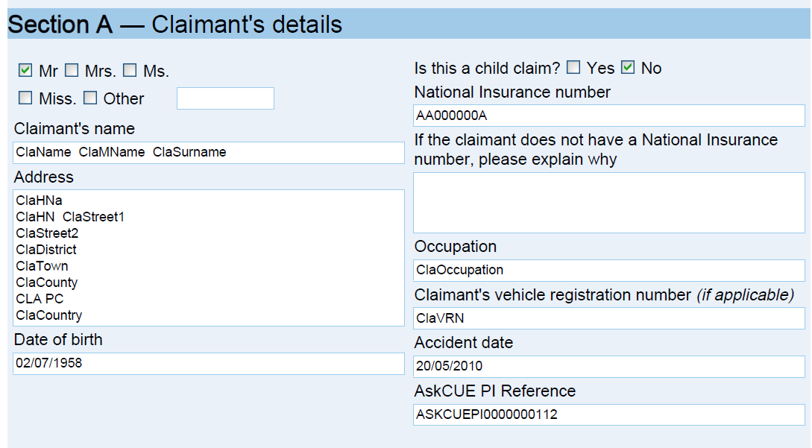
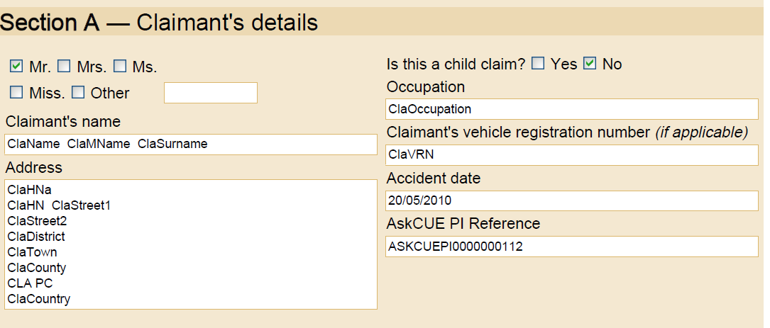
RTA Claims
Printable docs changed to include ASKCUEPIReference
1) CNF
2) CNF Insurer Response
3) Defendant Only CNF

Slide 7
RTA Claims
NEW FIELDS in ISPF: MedCO & Soft Tissue
InterimSettlementPackRequest
New REQUIRED attribute:
InterimSettlementPackRequest/ClaimantRepresentative/MedCoCase/
@SoftTissue
2) New CONDITIONAL attribute:
InterimSettlementPackRequest/ClaimantRepresentative/MedCoCase/
@MedCoCaseID

Slide 8
RTA Claims
NEW FIELDS in S2SPF: MedCO & Soft Tissue
Stage2SettlementPackRequest
1) New REQUIRED attribute:
Stage2SettlementPackRequest/ClaimantRepresentative/MedCoCase/
@SoftTissue
2) New CONDITIONAL attribute:
Stage2SettlementPackRequest/ClaimantRepresentative/MedCoCase/
@MedCoCaseID
GetClaim
1) New RETURNED attribute:Data/ApplicationData/ApplicationIDs/@MedcoCaseID

Slide 9
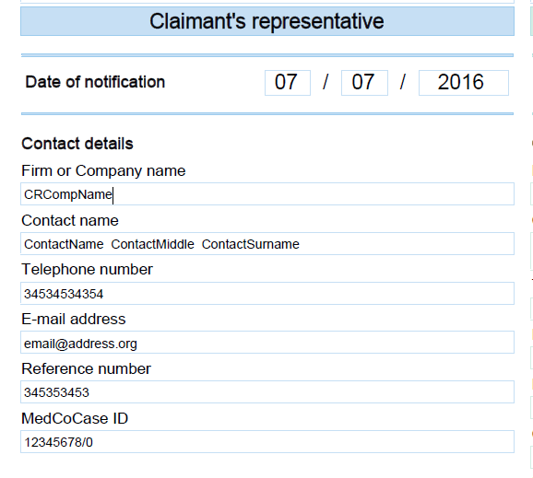
RTA Claims
Printable docs changed to include MedCO
Interim Settlement Pack
2) Stage 2 Settlement Pack

Slide 10
RTA\ELPL Claims
NEW FIELDS in ISPF : CRUReference & CRUComment
AddInterimSPFResponse
1) New OPTIONAL attribute
InterimSettlementPackResponse/DefendantRepresentative/CRUReference/
@CRUReferenceNumber
2) New CONDITIONAL* attribute
InterimSettlementPackResponse/DefendantRepresentative/CRUReference/
@CRUComment
*C:Mandatory if CRUReferenceNumber is empty

Slide 11
RTA\ELPL Claims
NEW FIELDS in S2SPF : CRUReference & CRUComment
AddStage2SPFResponse
1) New OPTIONAL attribute
Stage2SettlementPackResponse/DefendantRepresentative/CRUReference/
@CRUReferenceNumber
2) New CONDITIONAL* attribute
Stage2SettlementPackResponse/DefendantRepresentative/CRUReference/
@CRUComment
*C:Mandatory if CRUReferenceNumber is empty
GetClaim
1) New attribute RETURNED
Data/ApplicationData/ApplicationIDs/@CRUReferenceNumber

Slide 12
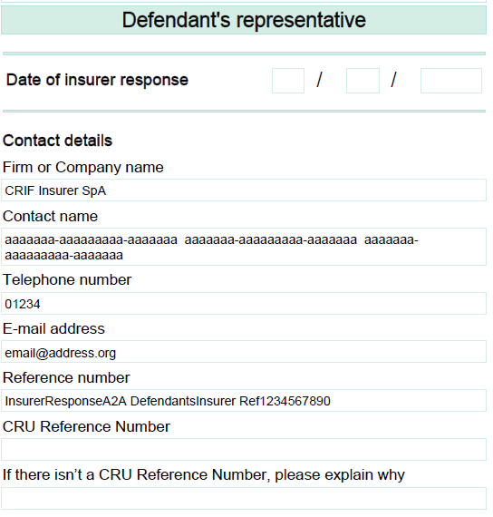
RTA\ELPL Claims
Printable docs including CRUReferenceNumber & CRUComment
Interim Settlement Pack
2) Stage 2 Settlement Pack

Slide 13
RTA\ELPL Claims
Claims Rejection: new fields and methods
RejectClaimTOCR
claimData
applicationID
activityEngineGuid
rejectionReasonCode (Input field introduced in Release 5)
Acknowledge Rejected Claim
New method introduced in Release 5
Exit Rejected Claim
New method introduced in Release 5

Slide 14
Bulk Transfer process
The BULK TRANSFER is a facility to transfer active Claims on the Portal from one organisation to another organisation of the same type. It is not possible to transfer claims from a Claimant Representative to a Compensator or vice versa and active would exclude drafts and any claim that is in an end phase.
Active claims will be transferred irrespective of the phase that they are in and which party CR or COMP has the claim to action. All portal timeouts on the claim will continue to advance within the destination organisation uninterrupted. The original source will always remain as the creator of the claim.
The PDF document already generated will not be changed and will keep the ORIGINAL data; this means that it will show the details of the old organisation in the already generated documents and the details of the new organisation will be shown in the “to be generated” documents. All the data documents containing data used to address the claim to the right organisation will be updated with the new organisation details.

Slide 15
RTA\ELPL Claims
Bulk Transfer: TransfersList node
The Bulk Transfer functionality allows an organisation to transfer claims to another organisation of the same type (from CR to CR, from COMP to COMP).
GetClaim
1) New node RETURNED
Data/ApplicationData/TransfersList
1.a) New attribute RETURNED
Data/ApplicationData/TransfersList/@Transferred
1.b) New node RETURNED
Data/ApplicationData/TransfersList/Transfer
[Note → There is a node Transfer per each transfer occurred for that claim]
This change will apply to all the claims in the Portal irrespective of the process version they have been created

Slide 16
RTA\ELPL Claims
Bulk Transfer: Transfer node
The node Transfer has two attributes:
New OPTIONAL Field TransferNumber
Data/ApplicationData/TransfersList/Transfer/@TransferID
[Note → It indicates the sequential number of the transfer]
New OPTIONAL Field TransferDescription
Data/ApplicationData/TransferList/Transfer/@TransferDesc
[Note → It indicates which organisations have been involved in the transfer and
when the transfer had been performed]

Slide 17
RTA\ELPL Claims
Notifications for Claims transferred (I)
When a claim is transferred from CR1 to CR2 (or from COMP1 to COMP2), the third party organisation COMP (or CR) is indirectly involved in the transfer and must be advised that the other party has changed.
In order to inform the third party organisations involved in a bulk transfer process, new notifications are generated and sent only to their A2A users.
GetNotificationsList
NEW OPTIONAL INPUT field: A2ANotifications
To receive the notifications sent to the A2A user the request must be sent by filling in the field “asUser” with the “A2A username”
As the bulk transfer process will only happen outside business hours over night or during the weekend, this function must be called once per day by the A2A client to keep their system up to date

Slide 18
RTA\ELPL Claims
GetNotificationsList for Claims transferred (II)
GetNotificationsList
INPUT:
userAuth
username – username for the A2A
password – password for the A2A
asUser
A2ANotifications – (Optional Input field introduced in Release 5)
To receive the notifications sent to the A2A user:
the request must be sent by filling in the field “asUser” with the “A2A username”
A2ANotifications must be present and set to TRUE

Slide 19
RTA\ELPL Claims
RemoveNotification for Claims transferred
RemoveNotification
username
Password
asUser
notificationID – the id of the notification to be deleted
A2ANotifications – Optional Input field introduced in Release 5
To remove a notification sent to the A2A user:
the request must be sent by filling in the field “asUser” with the “A2A username”
A2ANotifications must be present and set to TRUE

Slide 20
RTA\ELPL Claims
Stage 2 Settlement Pack counter offer timeout behaviour
NEW BEHAVIOUR FROM RELEASE 5
During a counter offer negotiation if the claim is at the Compensator side and it reaches the timeout
THEN
the claim is sent back to the Claimant Representative
and the Gross and Net amounts displayed in the last page of the S2SP Form are re-set by the portal to
the values inserted by the COMP in their previous valid counter offer

Slide 21
Preparation to Go Live

Slide 22
Preparation to Go live – RELEASE 5 MANAGE NEW VERSION (I)
29th November: GO LIVE DATE
DIFFERENT VERSIONS OF CLAIMS
USE GetSystemProcessVersion() to get the
VERSION MAJOR and VERSION MINOR
(AS FOR PREVIOUS RELEASES)

Slide 23
Preparation to Go live – RELEASE 5 MANAGE NEW VERSION (II)
CHECK THE PROCESS VERSION OF A CLAIM TO CALL THE RIGHT A2A FUNCTION
I.E. not later
than Monday
14th November
PROCESS VERSION FROZEN AT A GIVEN DATE
(RISK: no bug fixes)
RTA CURRENT
VERSION = 4.1
NO NEW VERSIONS
ELPL CURRENT
VERSION = 1.8
GO LIVE
29th November

Slide 24
Technical Documentation
TECH SPECS DRAFT version- A2A schema: describes the fields of Forms (XSD files)
Tech Specs A2A schema final version mid September
TECH SPECS - DRAFT A2A interface: describes the I/O of functions (WSDL file)
Tech Specs A2A interface final version mid September
WORKFLOW: graphical representation of the flow
A2A WORKFLOW: graphical representation of the A2A flow
PHASES AND NOTIFICATIONS: spreadsheet with the list of phases and notifications
A2A Release Notes DRAFT version- : describes the changes to the A2A
A2A Release Note final version mid to end of August

Slide 25
Integration sites and testing (I)
WEB TESTING (WEB Training site)
→ https://training.rapidclaimsettlement.org.uk
A2A TESTING (A2A Integration site)
→ https://piptesta2a.crif.com

Slide 26
Integration sites and testing (II)
A2A QUERIES to be directed to the Helpdesk
→ helpdesk@rapidclaimsettlement.org.uk
with e-mail subject “A2A QUERY RELEASE 5”
please include XML input and output with your queries
CHECK YOUR TEST CREDENTIALS
please check that your TEST credentials are enabled a couple of weeks or so before you start testing

